Slide 1


Slide 2
Indexed File Organization & B-Trees
Database System Slide
Submitted by: Group 3

Slide 3
Team Members:
Ahsan Riaz (BCSF18M009) Group Leader
Asad Ullah Waheed (BCSF18M023)
Usama Shoaib (BCSF18M015)

Slide 4
Topic
File Organization
Index and Index Classification
B- and B+ Tree

Slide 5
Introduction:
File organization refers to the way data is stored in a file.
File organization is very important because it determines the methods of access, efficiency, flexibility and storage devices to use.

Slide 6
How data is Stored in Database?
Database:
Database is an organized collection of related data where the data is stored and organized to serve some specific purpose
• The data is grouped within a table in RDBMS, and each table have related records.
A user can see that the data is stored in form of tables, but in actual this huge amount of data is stored in physical memory in form of files.
File:
A file is named collection of related information that is recorded on secondary storage such as magnetic disks, magnetic tables and optical disks.
A file is a collection of data that is treated as a single unit on a peripheral device.

Slide 7
Types of Files:
MASTER FILE
It contains record of permanent data types. They are created when you install your business.
2. Work files
A program can work efficiently if a work file is used.
3. TRANSACTION FILE
Contains data which is used to update the records of master file. The Transaction files also serves as history of the organization.

Slide 8
What is File Organization?
File Organization refers to the logical relationships among various records that constitute the file, particularly with respect to the means of identification and access to any specific record.
In simple terms, Storing the files in certain order is called file Organization.
File Structure refers to the format of the label and data blocks and of any logical control record.

Slide 9
Types of File Organization
1. Heap
Basically, these files are unordered files.
These files consist of randomly ordered records.
The records will have no particular order.
2. Sequential
Stored in key sequence. Adding/deleting requires making new file.
It is used as master file.
Records in these files can only be read or written sequentially.
3. Indexed File
Each record of a file has a key field which uniquely identifies that record.
An index consists of keys and addresses.

Slide 10
Types of File Organization
4. Direct access or Random Access
Records are read directly from or written on to the file.
The records are stored at known address.
Address is calculated by applying a mathematical function to the key field.
A random file would have to be stored on a direct access backing storage medium e.g. magnetic disc, CD, DVD.
5. Hashed file:
Hash file which uses a hash function to decide where a record should be placed on disk.

Slide 11
Comparison of Sequential, Index and Direct Access:
Sequential File | Index File | Direct Access/Random
Data is entered in entry sequential order | Data is entered in key sequential order | Data is entered in RRN Number (Reference Retrieval Number)
Delete is not applicable | Delete is applicable | Delete is applicable
Access is slow | Access is faster | Access is faster than index files
Key not available | Key is available. Key is user defined. It is a part of record. | Key is available. Key is system defined. It is outside of record.
We will discuss index File Organization in details.

Slide 12
What is index?
Indexing is a data structure technique which allows you to quickly retrieve records from a database file.
An Index is a small table having only two columns.
The first column comprises a copy of the primary or candidate key of a table.
Its second column contains a set of pointers for holding the address of the disk block where that specific key value stored.
An index takes a search key as input and efficiently returns a collection of matching records.
An index on a file speeds up selections on the search key fields for the index.

Slide 13
How to measure the merits of Indexes?
The merits of indexes can be measured in the following aspects:
1. Access types: The kind of access methods that can be supported efficiently (e.g. value-based search or range search).
2. Access time: Time needed to locate a particular record or a set of records.
3. Insertion efficiency: How efficient an insertion operation is.
4. Deletion efficiency: How efficient a deletion operation is.
5. Storage overhead: The additional storage requirement of an index structure.

Slide 14
Index Classification:
Classification of index are below:
Index
Primary Index
Clustering Index
Secondary Index
Multi Level Index
Desnse
Sparse
B+ Tree
B- Tree

Slide 15
Index Classification:
1. Primary indexes
A primary index is built for a file (the data file) sorted on its key field, and itself is another sorted file (the index file) whose records (index records) are of fixed-length with two fields.
The first field is of the same data type as the ordering key field of the data file, and the second field is a pointer to a disk block (i.e., the block address).
The ordering key field is called the primary key of the data file. There is one index entry (i.e., index record) in the index file for each block in the data file.
The primary Indexing in DBMS is also further divided into two types.
Dense Index
Sparse Index

Slide 16
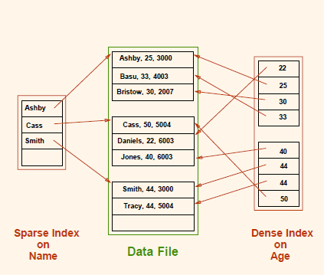
Index Classification:
a. Dense Index
In a dense index, a record is created for every search key valued in the database. This helps you to search faster but needs more space to store index records.
In this Indexing, method records contain search key value and points to the real record on the disk.
b. Sparse Index
It is an index record that appears for only some of the values in the file.
In this method of indexing technique, a range of index columns stores the same data block address, and when data needs to be retrieved, the block address will be fetched

Slide 17
Index Classification:
2. Clustering Indexes
If records of a file are physically ordered on a non-key field which may not have a unique value for each record, that field is called the clustering field.
Based on the clustering field values, a clustering index can be built to speed up retrieval of records that have the same value for the clustering field.
3. Secondary Indexes (Non-Clustering Indexes)
A secondary index is a sorted file of records (either fixed-length or variable length) with two fields.
The first field is of the same data type as an indexing field (i.e., a non-ordering field on which the index is built).
The second field is either a block pointer or a record pointer. A file may have more than one secondary index.

Slide 18
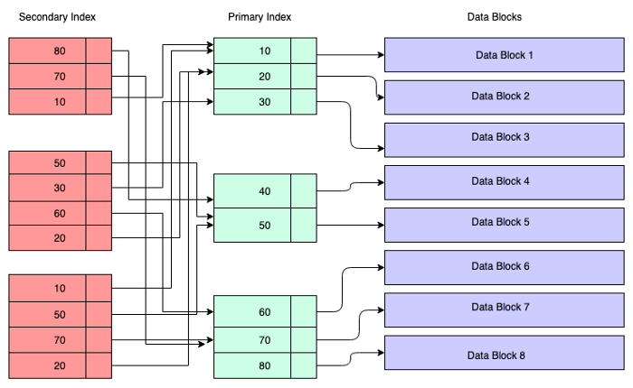
Index Classification:
Primary Index vs Secondary Index:
Primary Index pointer direct point to Data Block.
While Secondary Index pointer point to primary index

Slide 19
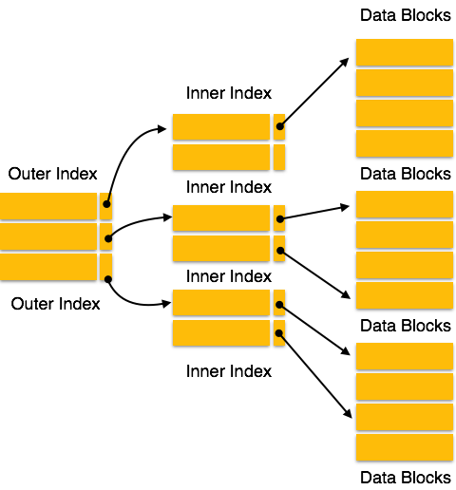
Index Classification:
4. Multilevel Indexes:
Multilevel Indexing in Database is created when a primary index does not fit in memory.
In this type of indexing method, you can reduce the number of disk accesses to short any record and kept on a disk as a sequential file and create a sparse base on that file.
There are two types:
(i) B- Tree (ii) B+ Tree

Slide 20
Multi Level Index B- Tree & B+ Tree:
What is B Tree?
B Tree is a binary tree, which has maximum two child nodes, i.e Left Child and Right child.
Left child will store smaller value than value of parent node, and right child store larger or equal to value of parent.
The height of binary tree is BigO(Log₂N). Where N is total node of tree.
20
8
25
10
12
23
30

Slide 21
B- Tree:
In computer science, a B-tree is a self-balancing tree data structure that maintains sorted data and allows searches, sequential access, insertions, and deletions in logarithmic time.
The B-tree generalizes the binary search tree, allowing for nodes with more than two children. It is commonly used in databases and file systems.
Definition of a B-tree
A B-tree of order p is a tree with the following constraints:
Each internal node is of the form <P1, <K1, Pr1>, P2, <K2, Pr2>, ……, Pq-1, <Kq-1, Prq-1>, Pq> where q <= p. Each Pi is a tree pointer –a pointer to another node in the B-tree. Each Pri is a data pointer – pointer to the block containing the record whose search field value is equal to Ki.
Within each node, K1 < K2 < …… < Kq-1., i.e Keys are in ascending order.

Slide 22
B- Tree:
For all search key field values X in the sub-tree pointed at by Pi, we have Ki-1 < X < Ki for 1 < i < q; X < Ki for i = 1; Ki-1 < X for i = q.
Each node has at most p tree pointers and p –1 search key values (p is the order of the tree and is the maximum limit).
Each node, except the root and leaf nodes, has at least #(p/2)# tree pointers and #(p/2)# - 1 search key values (i.e. must not be less than half full). The root node has at least two tree pointers (one search key value) unless it is the only node in the tree.

Slide 23
B- Tree:
A node with q tree pointers, q # p, has q – 1 search key field values (and hence has q – 1 data pointers).
All leaf nodes are at the same level. They have the same structure as internal nodes except that all of their tree pointers Pi are null.

Slide 24
B- Tree:
Advantages of B-Tree:
May use less tree nodes than a corresponding B+ Tree.
Sometimes possible to find search-key value before reaching leaf node.
Disadvantages of B-Tree:
Only small fraction of all search-key values are found early
B-Trees typically have greater depth than corresponding B+ Tree
Insertion and deletion more complicated than in B+ Trees
Implementation is harder than B+ Trees.

Slide 25
B+ Tree:
B+ tree is an extension of the B tree. The difference in B+ tree and B tree is that in B tree the keys and records can be stored as internal as well as leaf nodes whereas in B+ trees, the records are stored as leaf nodes and the keys are stored only in internal nodes.
The records are linked to each other in a linked list fashion. This arrangement makes the searches of B+ trees faster and efficient. Internal nodes of the B+ tree are called index nodes.

Slide 26
B+ Tree:
The following is an example of a B+ tree:

Slide 27
B+ Tree:
Advantages Of B+ Trees:
Compared to the B- tree, the height of the B+ tree is less and remains balanced.
Data in the B+ tree can be accessed sequentially or directly as the leaf nodes are arranged in a linked list.
Search is faster as data is stored in leaf nodes only and as a linked list.
Disadvantages of B+ Tree:
Difficult to implement

Slide 28
Difference Between B- Tree & B+ Tree
B- tree | B+ tree
All internal and leaf nodes have data pointers | Only leaf nodes have data pointers
Since all keys are not available at leaf, search often takes more time. | All keys are at leaf nodes, hence search is faster and accurate..
No duplicate of keys is maintained in the tree. | Duplicate of keys are maintained and all nodes are present at leaf.
Insertion takes more time and it is not predictable sometimes. | Insertion is easier and the results are always the same.
Deletion of internal node is very complex and tree has to undergo lot of transformations. | Deletion of any node is easy because all node are found at leaf.
Leaf nodes are not stored as structural linked list. | Leaf nodes are stored as structural linked list.

Slide 29
Referenced Links:
Below are links for the visualization of B- & B+ Tree
B- Tree
https://www.cs.usfca.edu/~galles/visualization/BTree.html
B+ Tree
https://www.cs.csubak.edu/~msarr/visualizations/BPlusTree.html

Slide 30


